Slide 1
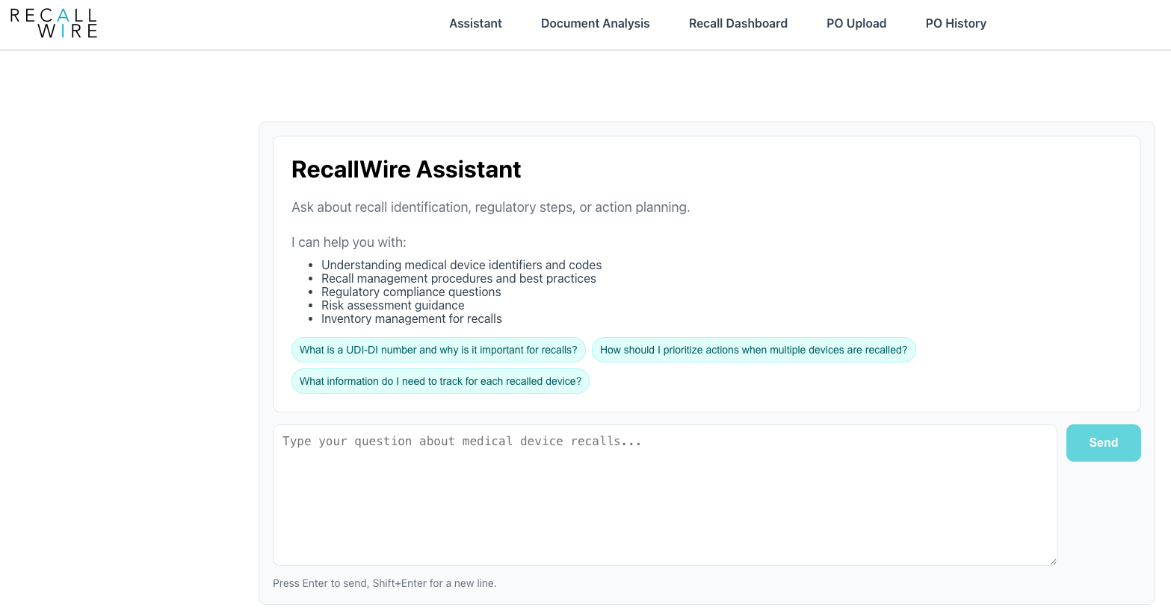
Live Wires

Slide 2
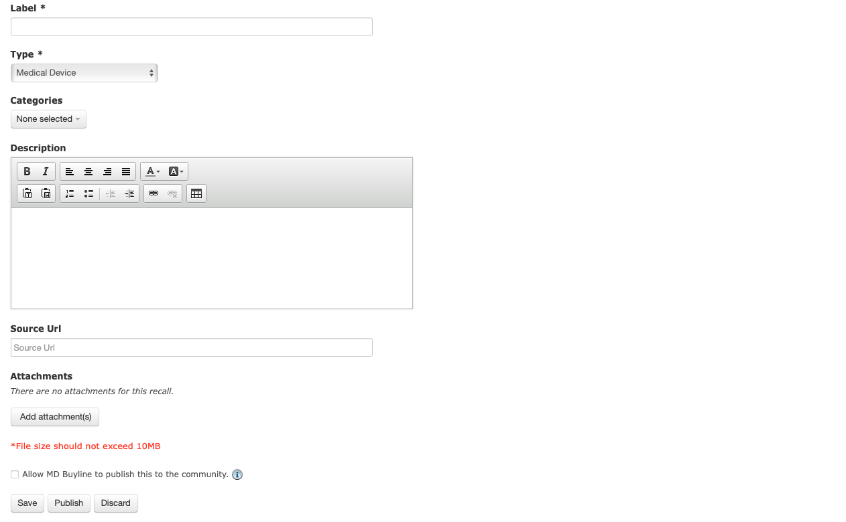
Live Wires include: Target 25-45d faster than FDA
Immediate Vendor produced notices
FDA Early Alerts
Distributor notices
Software-related and/or Cyber Threats
Intent: To deliver recalls before any competitor 3rd party
Requirements:
Free form page with similar attributes as seen here
with admin capabilities to push “Live Wires” out to clients.
Ability to include original PDF attachment and/or Source URL
to article.
Functionality:
Customer with POH integration will scan against recall info to see if affected. If affected, auto push to client.
Customers without POH integration will receive raw ”Live Wire”
This will consist of the Recall Notice only in its raw form, triggering
immediate action on the client end.

